Slide 1
Case Study Part 1
By Alexis, Nicole, Rosine, Israel

Slide 2
Task 1: Density Function
Clearly explain the density function “density” that you used.
The density function used calculates the density at the specified point in a circular radius of 5km, given the geographic data as a data structure with a KD-tree, density matrix and array of all the trajectory points. A KD-tree is a k-dimensional tree (in this case k=2) that is good at storing and searching for coordinates in a k-dimensional space. The mathematical formula is (the number of points within the circle of radius r centered at point p) divided by (the area of the circle). We then store whatever density is calculated in a “density matrix”, so that the next time we want to calculate the density of the same point, it will be in constant time.

Slide 3
Task 1: Density Function
The reason for choosing the specified function
We chose to calculate the density in this way because it provided a very quick method of searching all points in a specified radius of a specific point, by eliminating all points we know can’t be found in the desired region first. It also limits the number of times we have to call the euclidean distance formula, which has some overhead.
Describe each parameter in the parameter set Θ
The parameters given to the density function were
p: the center point for which to calculate the density
root: the root of the KD-tree holding the full dataset of trajectory points
r: the radius from the center point for which to calculate the density (# of points per km^2)

Slide 4
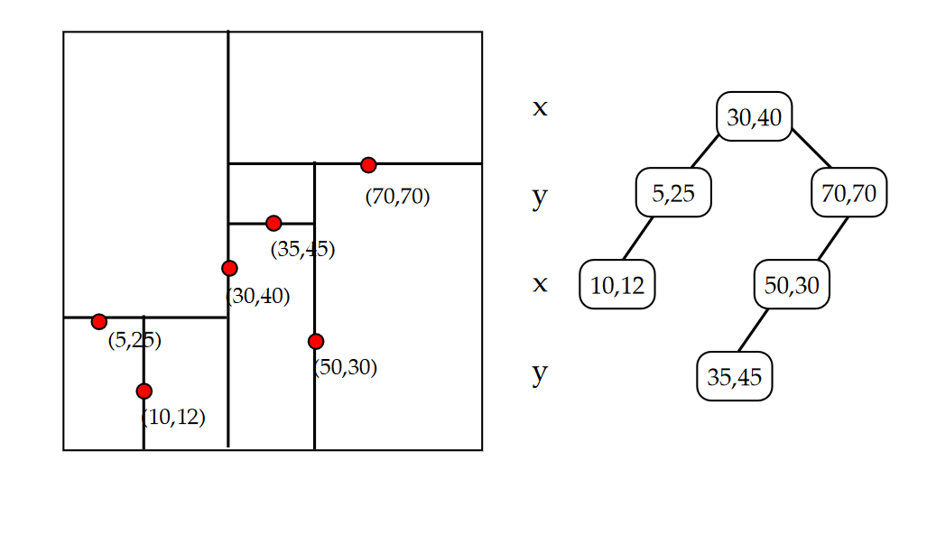
Task 1: Density Function
Illustrate density calculation with an example.
KD-trees work similar to BSTs except the value used to branch the tree depends on the level of the node. For example, the root sorts its children by the first coordinate value, and its children sorts their children by the second coordinate value, and the cycle repeats
Take the tree at the right for instance.Let’s say we wanted to find the density of a point centered at (5,25) with a radius of 5.

Slide 5
Task 1: Density Function
We first go to the root node. If this point is in the search area, then we add it to the number of nodes within this area and run the algorithm recursively on its left and right children.
If a point is not within the area, then we check if its due to the coordinate value used to sort its children. If it is, then we know whether to move to ONLY its right or left child because then we can get closer to the area we are looking for.

Slide 6
Task 1: Density Function
If it is not because of the coordinate the node sorts by, then we still just check the left and right child recursively
In this case, the point is not in the area because the x coordinate 30 is outside the bounds, thus we then only run the algorithm recursively on its left child, which is closer to (5, 25)
We see (5, 25) is within the area we’re looking for, so we check both its children
We see (10, 12) is not within the area and a leaf node, so we’re done running the algorithm

Slide 7
Task 1: Density Function
Once we’re done with the calculation, we store the result in a density matrix so the next time we need the value it is in constant time.
After preprocessing the data the density function will run in constant time.

Slide 8
Task 1: Density Function
Describe the preprocessing algorithm and the algorithm for computing density(p).
For preprocessing, we use a data structure called GeographicData which is comprised of an array, a matrix, and a KD-tree\
The array stores all coordinate points
The matrix is a density matrix storing the density of a specific point, using the points coordinates to get the indices of the matrix: floor(x-min_x) and floor(y-min_y). Here min_x and min_y refer to the minimum x and y values from all coordinates. This is so we don’t use negative indices in the matrix
The preprocessing algorithm goes through every point in the csv file and reads all coordinate pairs. O(n) time
Then it stores all these values in the all_points array in GeographicData. O(1) time
We then shuffle these values ( O(N) )and insert all of them into a KD-tree ( O(n log n))
We then go through all the points in all_points and calculate the densities using the tree for these values in the density matrix. O(n logn) time

Slide 9
Task 1: Density Function
Filling the density matrix is O(n logn) time because the function for calculating the density using the KD-tree first is O(logn) and we run this n times
Building the KD-tree takes O(n logn) time because inserting the nodes takes O(logn) time and we run this O(n) times
Once we have built the all_points array, the density_matrix, and the kd_tree, we have finished preprocessing all the data.
This preprocessing step took O(n logn) time as shown above

Slide 10
Task 1: Density function
The algorithm for the density function:
Once preprocessing is done, the final density function used will take O(1) time for values we have seen before, which will be in the average case. This is because we simply access the density_matrix at the specific indices, which takes O(1). For the worst case, the algorithm will run in O(logn) to find the density of a point we haven’t seen before and then store it into the density matrix. This will then take O(1) time the next time.
State the time complexity of density (p).
The time complexity of density(p) takes O(1) time because we simply access density_matrix[ floor(p.x - min_x)] [floor(p.y - min_y)] which is a constant time operation.

Slide 11
Task 1: hubs(P, k, r)
Describe the hubs (P;k,r) procedure. State its time complexity.
The hubs procedure works as a method of the GeographicData class data structure. We simply use a top k largest elements algorithm to compute k points of high density that are at least a distance r apart
First we use a heap to store k points in a list that are r distance apart from each other. We do this by iterating through the points of the dataset and adding any point that satisfies the criteria.
Then we iterate from the kth element of the list to the last one, the nth. O(n). We do the following
We use our density function to find if the density of the current point is greater than the minimum density of our heap. If it’s not we skip this point O(1)
If it is, then we check if its at least r away from all other points in the heap. O(k) , if it’s not then we skip
If the new point satisfies all criteria, then we add it to the heap and move to the next point
All of this portion of the code takes O(kn) = O(n) time complexity
Thus the total time complexity of the hubs algorithm takes O(n) time complexity

Slide 12
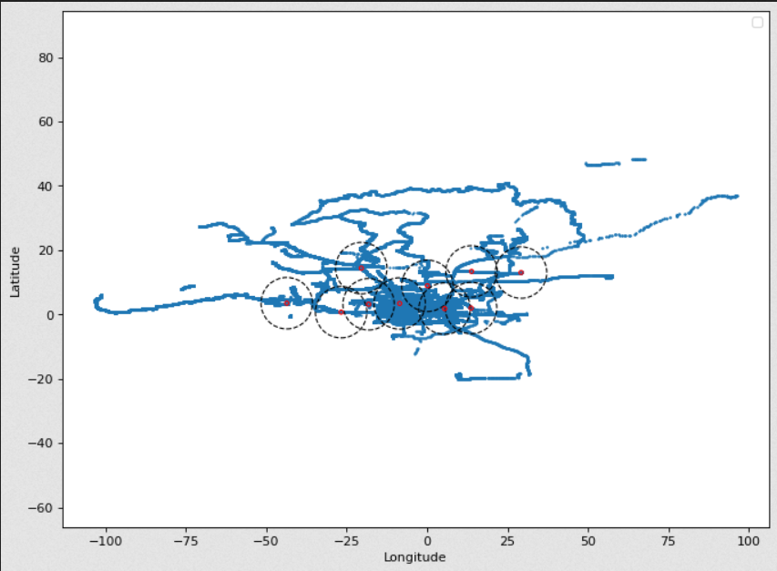
Task 1: experimental results from Section 3.2.
These are the hubs generated with parameters k=10 and r=8km.
The blue dots are the trajectory points.
The red circles are the hubs center.
The black dotted circles indicate the separating distance r.

Slide 13
Task 1: experimental results from Section 3.2.
The hubs algorithm at different values of k for the same value of r = 2 km | Runtime for trial 1 (in milliseconds) | Runtime for trial 2 (in milliseconds) | Runtime for trial 3 (in milliseconds)
K = 5 | 1591.889 | 1606.357 | 1564.897
K = 10 | 1737.859 | 1625.894 | 1652.735
K = 20 | 1924.238 | 1941.053 | 1915.683
K = 40 | 2148.695 | 2111.567 | 2212.2537

Slide 14
Task 1: experimental results from Section 3.2.
% of subset | K and R values | Runtime in milliseconds
10% subset | K = 10 and r = 8 | 148.1318473815918
30% subset | K = 10 and r = 8 | 444.5412158966064
60% subset | K = 10 and r = 8 | 953.9210796356201
100% subset | K = 10 and r = 8 | 1525.783777236938

Slide 15
Task 1: Benefits and Drawbacks of the Hubs
Benefits:
We don’t have to run more calculations once we know a point is too close to all points in the heap
The algorithm is entirely self contained because of the data structure used to preprocess the data
Because we only look at trajectory points, density will always be in O(1)
Using a heap for hubs helps store the hubs by density
The algorithm works great on sparse data sets where points are far apart
Drawbacks:
The algorithm still has some dependence on k in the final time complexity
The algorithm is very liberal with the number of times it calls density
The algorithm is not as efficient on dense datasets

Slide 16
Task 1: Potential Avenues for Further Improvement
Some avenues for improvement
Find a way to remove the algorithms dependence on k for runtime complexity
Find a way to collect the top most dense hubs rather than an assortment of just high density hubs
Find a way to reduce the number of calls to density
Make the algorithm better for dense datasets
Store a set of data points that are a set distance apart to have somewhere to start from when calling hubs

Slide 17
Task 2: proposed trajectory simplification algorithm
The algorithm takes in the original trajectory and an error parameter.
It returns an e-simplification of the original trajectory.
It then finds the vector between the endpoints of T.
Next, it computes the point farthest from said vector.
If the max distance is less than ε, it returns the e-simplification.
Else, add the farthest point to the e-simplification and split the original trajectory into two sub-trajectories from the farthest point.
Recursively apply the algorithm to the sub-trajectories.
Return the e-simplification.
Runtime: O(|T|log|T|) on average

Slide 18
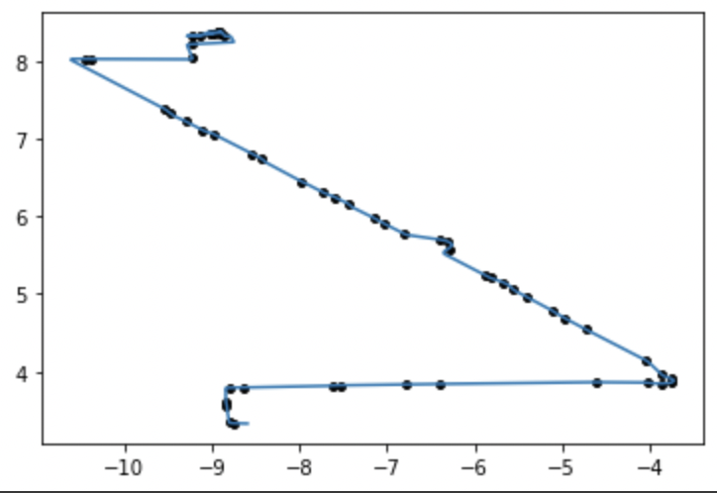
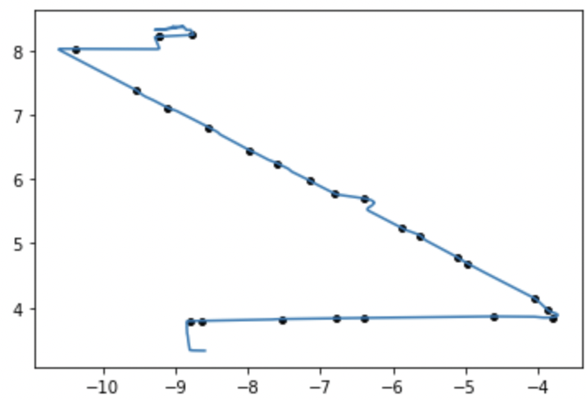
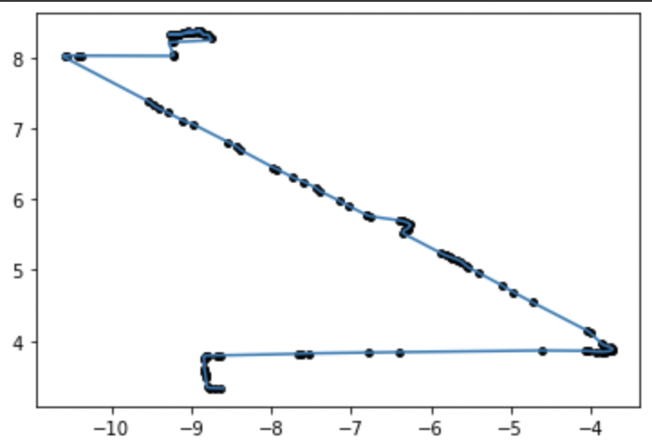
Task 2: Experimental Results
128-20080503104400-
3.0
010-20081016113953-
5.967032967032967
115-20080520225850-
1.9821162444113263
115-20080615225707-
2.158682634730539
ε=0.1
ε=0.3
ε=0.03

Slide 19
Task 2: Advantages and Drawbacks
Advantages:
The algorithm has an average case runtime of O(|T|log|T|) so it is efficient in that regard.
It is a practical algorithm that is sufficient for reaching a short-term approximation.
You can adjust the error level based on your needs.
Drawbacks:
It only considers the local simplification which might not even be the smallest size possible for the e-simplification (gives n optimal solutions).
It’s not holistic so intricate trajectories might throw off the results. (i.e the farthest point from the vector is 2nd or 2nd to last.)
Could lead to loss of important points in some cases.

Slide 20
Task 2: Future scope for Enhancement
The algorithm could be enhanced to automatically detect the optimal ε-simplification needed for individual trajectory regions instead of having to specify for the entire trajectory.
A future algorithm could also consider the curves of the trajectory as the current greedy algorithm uses the distance between points (a straight line) to determine those to remove.
Another enhancement could be to consider points of interest because the algorithm seeks to find the minimum number of points required for simplification but in the real world some points might be essential even with a low error.
Some new GPS features include avoid tolls or highways so an enhancement could be to remove points that have undesired features.

Slide 21
Task 3
E_avg:
Algorithm: A dynamic programming to compute the dtw for the optimal monotone assignment between two trajectories, P and Q. It does so with the following recurrence relation:
Returns: an array containing all the pairs of E_{avg} in indices [0...n-2] and the dtw for that assignment in the index [n-1].
The runtime complexity and the space complexity are both O(|P|*|Q|)
Dtw:
Algorithm: Takes as input the array obtained in E_avg and returns the last element in that array, which is the dtw of assignment E_{avg}.
The runtime complexity and the space complexity for this function are both O(1)

Slide 22
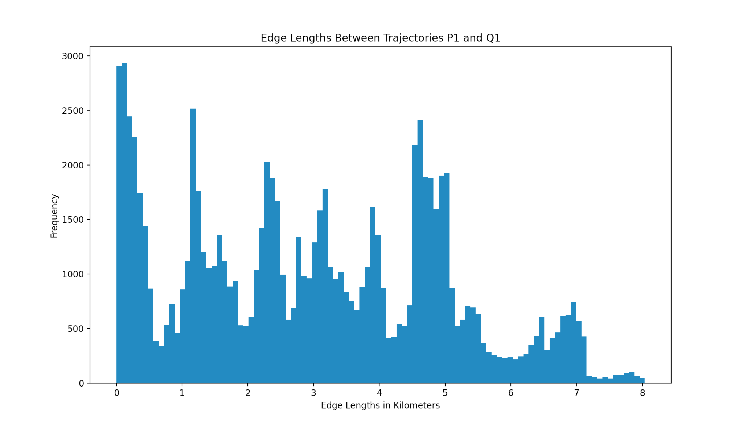
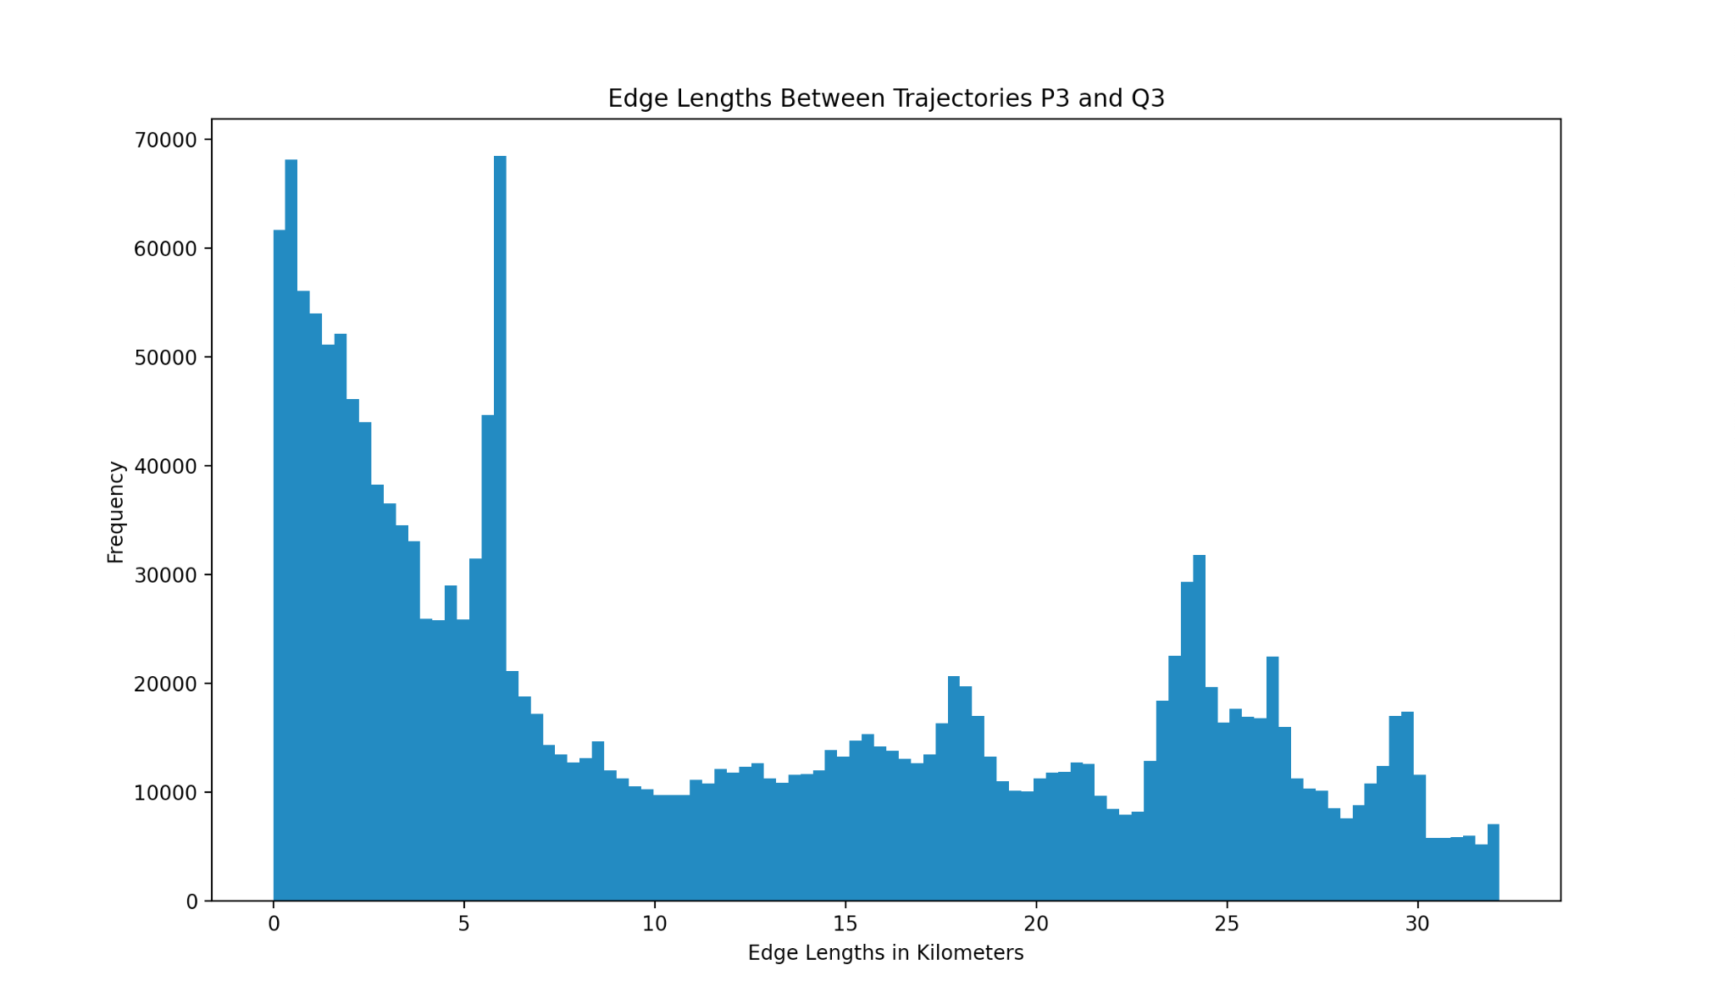
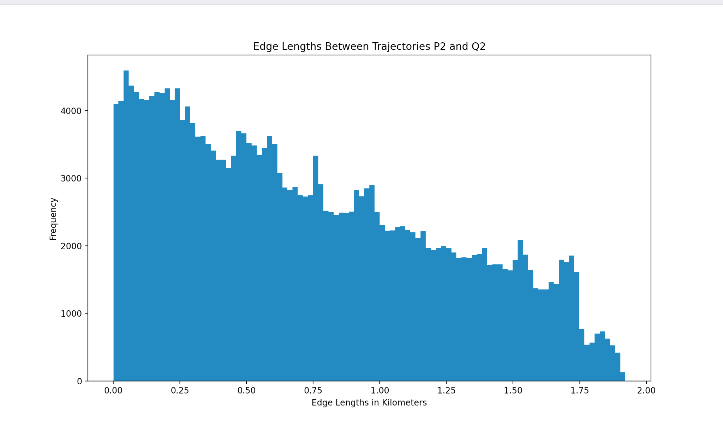
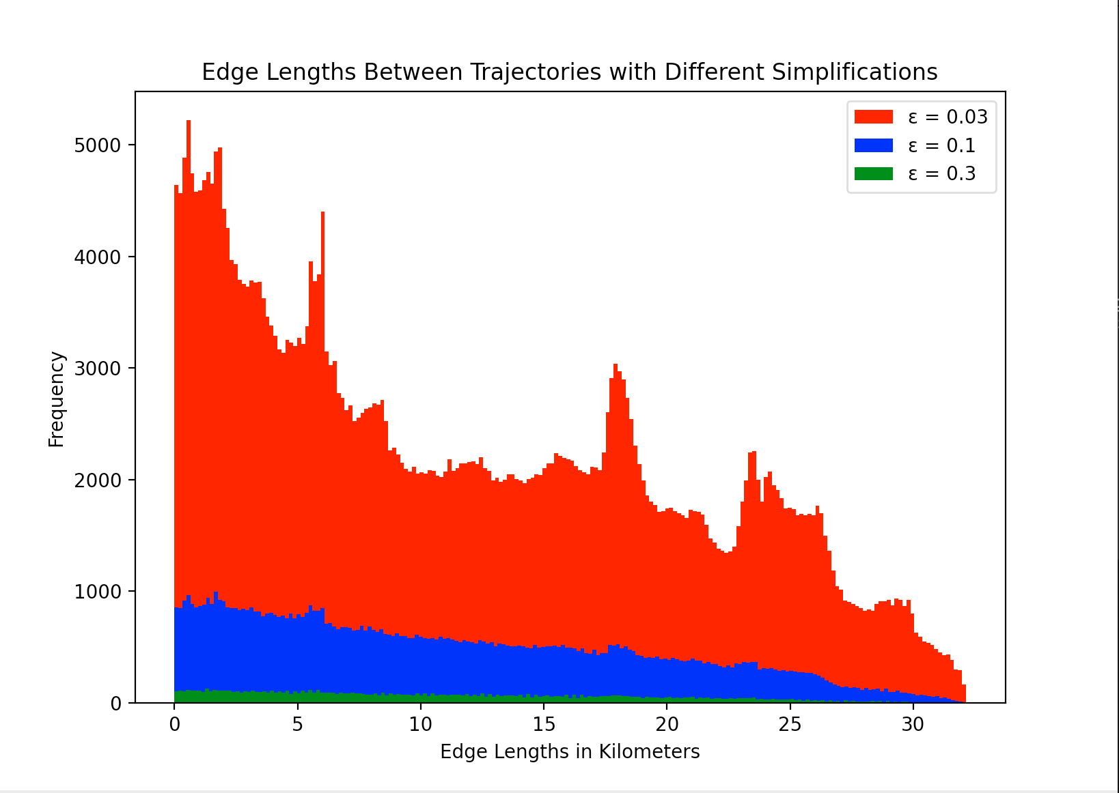
Task 3
Task
3:
E_avg
P1, Q1: Dtw = 0.010811333491296746
P3, Q3: Dtw = 0.37873881639749035
P2, Q2: Dtw = 3.1373601334975384e-05
Ε-simplifications for E_{avg}
Notes:
Experimental results for E_avg

Slide 23
Task 3:Advantages and Drawbacks of E_avg
Advantages:
The use of dynamic programming ensures that we are not recomputing values, making the algorithm efficient for large sets of data
As we compute the optimal assignment for two trajectories, we are computing the optimal assignment for any subsequence of the trajectories as well
Drawbacks
The space complexity is O(|P|*|Q|), so it does use a substantial amount of memory, especially when processing large data sets
The output is an array with two different types of information, the pairs in E_avg and the dtw value for the E_avg. The formatting of this output could be potentially confusing for use in other computations.

Slide 24
Task 3
E_Max:
Dynamic programming is similarly used to compute fd for the optimal monotone assignment between trajectories P and Q. With its recurrence relation being the following:
The functions returns an array containing all of the edges in the optimal assignment and the fd of that assignment
The runtime complexity and the space complexity are O(|P|*|Q|)
Fd:
The function's input takes in an array and returns the last element of the array. For the implementation for task 3, the array which is passed into the function is the same array that is the result of calling E_max on two trajectories. This means the element returned is the fd of an assignment.
The runtime complexity and the space complexity for this function are both O(1)

Slide 25
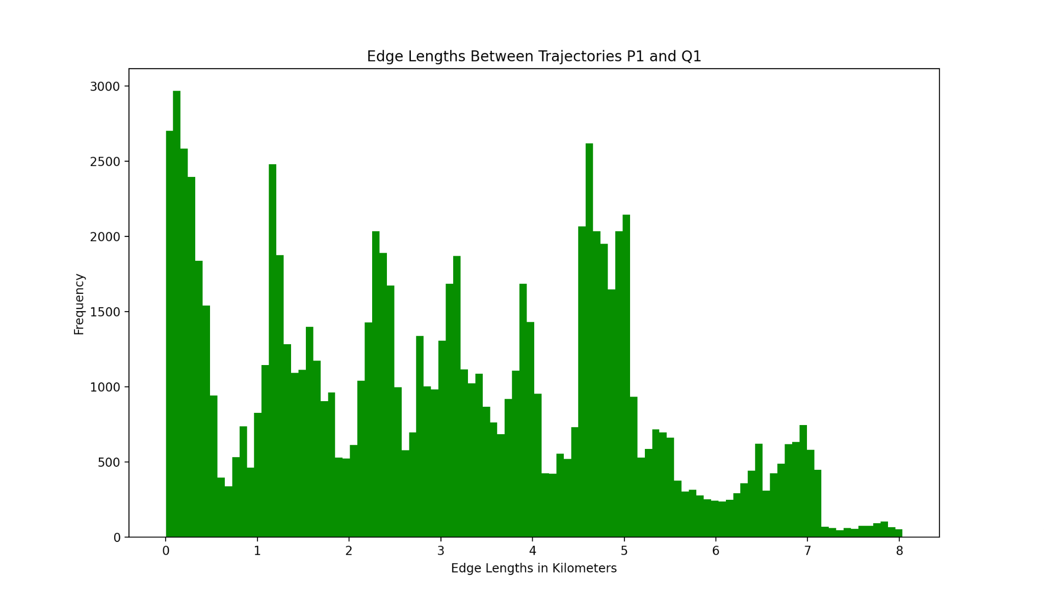
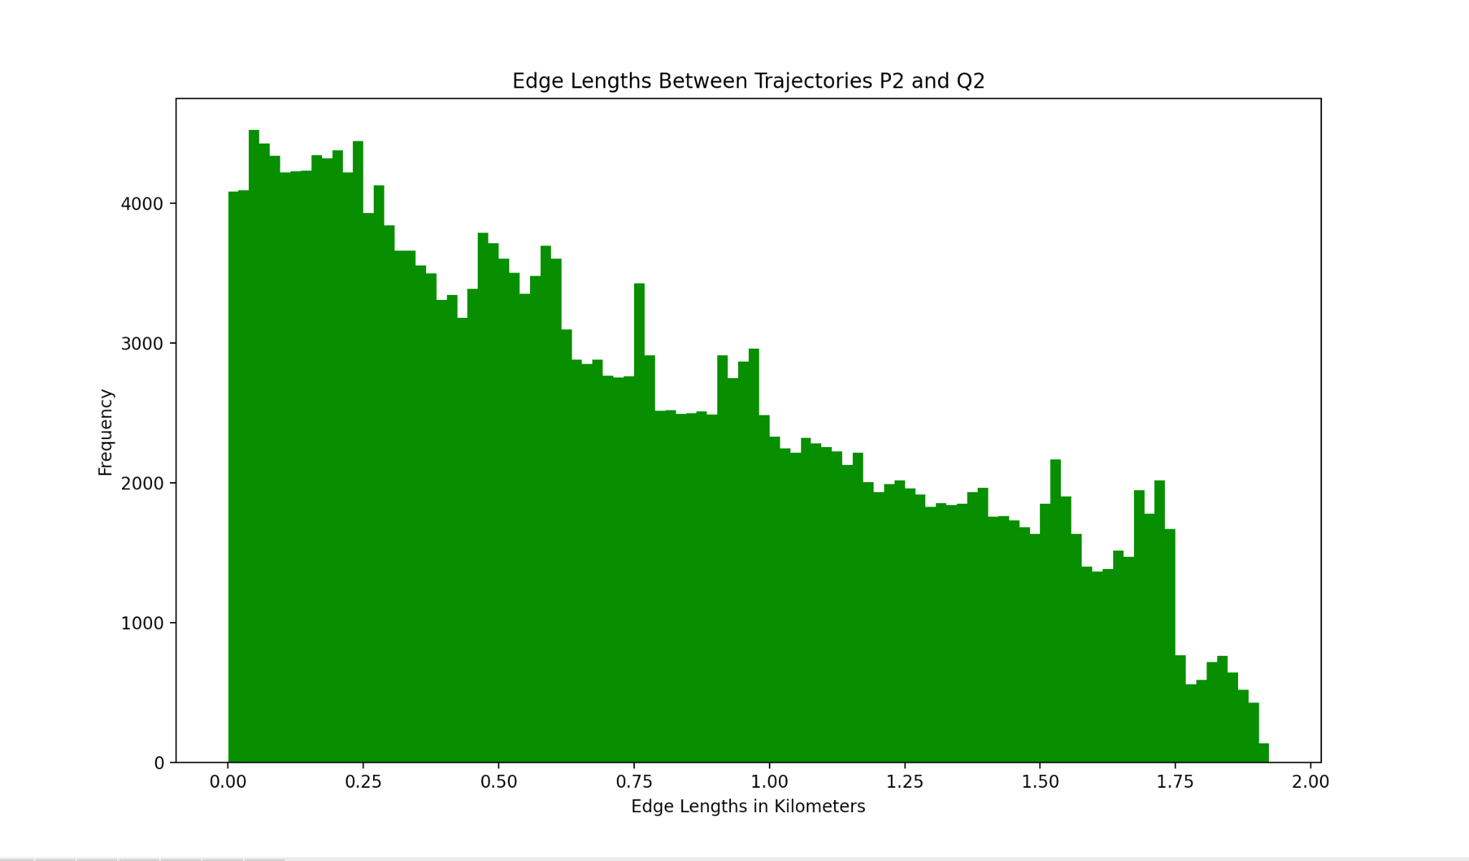
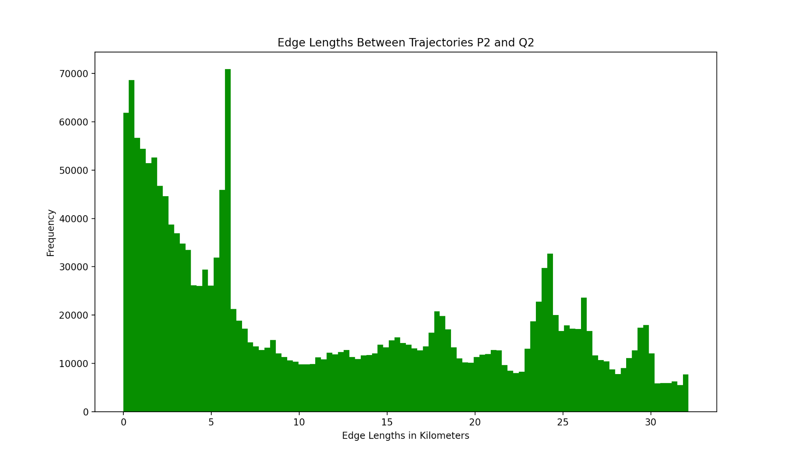
Task 3: E_max
P1, Q1: fd = 0.0034848529380753384
P2, Q2: fd = 0.007024339399544827
P3, Q3: fd = 15.062574206535745

Slide 26
Task 3: Advantages and Drawbacks
Advantages:
The algorithm uses a dynamic programming approach so it’s efficient for large datasets
The algorithm implements memoization to avoid redundant computations which further improves its efficiency
The algorithm is generalized so it can work with any pair of trajectories which makes it versatile for different datasets
Drawbacks:
The algorithm is sensitive to outliers in input trajectories which could produce unreliable results
The algorithm implements the Fréchet distance algorithm which makes it computationally expensive for large input trajectories

Slide 27
Describes the Contribution of Each Group Member
Alexis:Implemented Task 1
Nicole:Implemented Task 3 (dtw(P,Q)& Eavg) README file
Rosine:Implemented Task 2
Israel:Implemented Task 3 (fd(P,Q)& Emax) README file

